Slide 1
SQL Training: Day 08
Iqra Technology (www.iqratechnology.com)

Slide 2
In this session we will learn:
Constraints:
NOT NULL
UNIQUE
PRIMARY KEY
FOREIGN KEY
CHECK
DEFAULT
How to create database diagram

Slide 3
NOT NULL

Slide 4
NOT NULL :
SQL NOT NULL Constraint
By default, a column can hold NULL values.
The NOT NULL constraint enforces a column to NOT accept NULL values.
This enforces a field to always contain a value, which means that you cannot insert a new record, or update a record without adding a value to this field.
SQL NOT NULL on CREATE TABLE
The following SQL ensures that the "ID", "LastName", and "FirstName" columns will NOT accept NULL values when the "Persons" table is created:
CREATE TABLE Persons (
ID int NOT NULL,
LastName varchar(255) NOT NULL,
FirstName varchar(255) NOT NULL,
Age int
);

Slide 5
NOT NULL :
SQL NOT NULL on ALTER TABLE
To create a NOT NULL constraint on the "Age" column when the "Persons" table is already created, use the following SQL:
ALTER TABLE Persons
ALTER COLUMN Age int NOT NULL;

Slide 6
UNIQUE

Slide 7
UNIQUE :
SQL UNIQUE Constraint
The UNIQUE constraint ensures that all values in a column are different.
Both the UNIQUE and PRIMARY KEY constraints provide a guarantee for uniqueness for a column or set of columns.
A PRIMARY KEY constraint automatically has a UNIQUE constraint.
However, you can have many UNIQUE constraints per table, but only one PRIMARY KEY constraint per table.
SQL UNIQUE Constraint on CREATE TABLE
The following SQL creates a UNIQUE constraint on the "ID" column when the "Persons" table is created:
SQL Server / Oracle / MS Access:
CREATE TABLE Persons (
ID int NOT NULL UNIQUE,
LastName varchar(255) NOT NULL,
FirstName varchar(255),
Age int
);

Slide 8
UNIQUE :
To name a UNIQUE constraint, and to define a UNIQUE constraint on multiple columns, use the following SQL syntax:
MySQL / SQL Server / Oracle / MS Access:
CREATE TABLE Persons (
ID int NOT NULL,
LastName varchar(255) NOT NULL,
FirstName varchar(255),
Age int,
CONSTRAINT UC_Person UNIQUE (ID,LastName)
);
SQL UNIQUE Constraint on ALTER TABLE
To create a UNIQUE constraint on the "ID" column when the table is already created, use the following SQL:
MySQL / SQL Server / Oracle / MS Access:
ALTER TABLE Persons
ADD UNIQUE (ID);

Slide 9
UNIQUE :
To name a UNIQUE constraint, and to define a UNIQUE constraint on multiple columns, use the following SQL syntax:
MySQL / SQL Server / Oracle / MS Access:
ALTER TABLE Persons
ADD CONSTRAINT UC_Person UNIQUE (ID,LastName);
DROP a UNIQUE Constraint
To drop a UNIQUE constraint, use the following SQL:
SQL Server / Oracle / MS Access:
ALTER TABLE Persons
DROP CONSTRAINT UC_Person;

Slide 10
CHECK

Slide 11
CHECK :
SQL CHECK Constraint
The CHECK constraint is used to limit the value range that can be placed in a column.
If you define a CHECK constraint on a column it will allow only certain values for this column.
If you define a CHECK constraint on a table it can limit the values in certain columns based on values in other columns in the row.
SQL CHECK on CREATE TABLE
The following SQL creates a CHECK constraint on the "Age" column when the "Persons" table is created. The CHECK constraint ensures that the age of a person must be 18, or older:
SQL Server / Oracle / MS Access:
CREATE TABLE Persons (
ID int NOT NULL,
LastName varchar(255) NOT NULL,
FirstName varchar(255),
Age int CHECK (Age>=35)
);

Slide 12
CHECK :
To allow naming of a CHECK constraint, and for defining a CHECK constraint on multiple columns, use the following SQL syntax:
MySQL / SQL Server / Oracle / MS Access:
CREATE TABLE Persons (
ID int NOT NULL,
LastName varchar(255) NOT NULL,
FirstName varchar(255),
Age int,
City varchar(255),
CONSTRAINT CHK_Person CHECK (Age>=18 AND City='Sandnes')
);
SQL CHECK on ALTER TABLE
To create a CHECK constraint on the "Age" column when the table is already created, use the following SQL:
MySQL / SQL Server / Oracle / MS Access:
ALTER TABLE Persons
ADD CHECK (Age>=18);

Slide 13
CHECK :
To allow naming of a CHECK constraint, and for defining a CHECK constraint on multiple columns, use the following SQL syntax:
MySQL / SQL Server / Oracle / MS Access:
CREATE TABLE Persons (
ID int NOT NULL,
LastName varchar(255) NOT NULL,
FirstName varchar(255),
Age int CHECK (Age>=18)
);
To allow naming of a CHECK constraint, and for defining a CHECK constraint on multiple columns, use the following SQL syntax:
MySQL / SQL Server / Oracle / MS Access:
CREATE TABLE Persons (
ID int NOT NULL,
LastName varchar(255) NOT NULL,
FirstName varchar(255),
Age int,
City varchar(255),
CONSTRAINT CHK_Person CHECK (Age>=18 AND City='Sandnes')
);

Slide 14
CHECK :
SQL CHECK on ALTER TABLE
To create a CHECK constraint on the "Age" column when the table is already created, use the following SQL:
MySQL / SQL Server / Oracle / MS Access:
ALTER TABLE Persons
ADD CHECK (Age>=18);
To allow naming of a CHECK constraint, and for defining a CHECK constraint on multiple columns, use the following SQL syntax:
MySQL / SQL Server / Oracle / MS Access:
ALTER TABLE Persons
ADD CONSTRAINT CHK_PersonAge CHECK (Age>=18 AND City='Sandnes');
DROP a CHECK Constraint
To drop a CHECK constraint, use the following SQL:
SQL Server / Oracle / MS Access:
ALTER TABLE Persons
DROP CONSTRAINT CHK_PersonAge;

Slide 15
DEFAULT

Slide 16
DEFAULT :
SQL DEFAULT Constraint
The DEFAULT constraint is used to set a default value for a column.
The default value will be added to all new records, if no other value is specified.
SQL DEFAULT on CREATE TABLE
The following SQL sets a DEFAULT value for the "City" column when the "Persons" table is created:
My SQL / SQL Server / Oracle / MS Access:
CREATE TABLE Persons (
ID int NOT NULL,
LastName varchar(255) NOT NULL,
FirstName varchar(255),
Age int,
City varchar(255) DEFAULT 'Sandnes'
);
The DEFAULT constraint can also be used to insert system values, by using functions like GETDATE():
CREATE TABLE Orders (
ID int NOT NULL,
OrderNumber int NOT NULL,
OrderDate date DEFAULT GETDATE()
);

Slide 17
DEFAULT :
SQL DEFAULT on ALTER TABLE
To create a DEFAULT constraint on the "City" column when the table is already created, use the following SQL:
ALTER TABLE Persons
ADD CONSTRAINT df_City
DEFAULT 'Sandnes' FOR City;

Slide 18
PRIMARY KEY

Slide 19
PRIMARY KEY:
SQL PRIMARY KEY Constraint
The PRIMARY KEY constraint uniquely identifies each record in a table.
Primary keys must contain UNIQUE values, and cannot contain NULL values.
A table can have only ONE primary key; and in the table, this primary key can consist of single or multiple columns (fields).
SQL PRIMARY KEY on CREATE TABLE
The following SQL creates a PRIMARY KEY on the "ID" column when the "Persons" table is created:
CREATE TABLE Persons (
ID int NOT NULL PRIMARY KEY,
LastName varchar(255) NOT NULL,
FirstName varchar(255),
Age int
);

Slide 20
PRIMARY KEY:
To allow naming of a PRIMARY KEY constraint, and for defining a PRIMARY KEY constraint on multiple columns, use the following SQL syntax:
CREATE TABLE Persons (
ID int NOT NULL,
LastName varchar(255) NOT NULL,
FirstName varchar(255),
Age int,
CONSTRAINT PK_Person PRIMARY KEY (ID,LastName)
);
SQL PRIMARY KEY on ALTER TABLE
To create a PRIMARY KEY constraint on the "ID" column when the table is already created, use the following SQL:
MySQL / SQL Server / Oracle / MS Access:
ALTER TABLE Persons
ADD PRIMARY KEY (ID);

Slide 21
PRIMARY KEY:
To allow naming of a PRIMARY KEY constraint, and for defining a PRIMARY KEY constraint on multiple columns, use the following SQL syntax:
MySQL / SQL Server / Oracle / MS Access:
ALTER TABLE Persons
ADD CONSTRAINT PK_Person PRIMARY KEY (ID,LastName);
DROP a PRIMARY KEY Constraint
To drop a PRIMARY KEY constraint, use the following SQL:
ALTER TABLE Persons
DROP CONSTRAINT PK_Person;

Slide 22
FOREIGN KEY

Slide 23
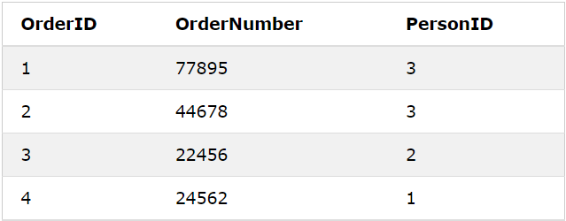
FOREIGN KEY:
SQL FOREIGN KEY Constraint
The FOREIGN KEY constraint is used to prevent actions that would destroy links between tables.
A FOREIGN KEY is a field (or collection of fields) in one table, that refers to the PRIMARY KEY in another table.
The table with the foreign key is called the child table, and the table with the primary key is called the referenced or parent table.
Look at the following two tables:
Persons Table
Orders Table

Slide 24
FOREIGN KEY:
Notice that the "PersonID" column in the "Orders" table points to the "PersonID" column in the "Persons" table.
The "PersonID" column in the "Persons" table is the PRIMARY KEY in the "Persons" table.
The "PersonID" column in the "Orders" table is a FOREIGN KEY in the "Orders" table.
The FOREIGN KEY constraint prevents invalid data from being inserted into the foreign key column, because it has to be one of the values contained in the parent table.
SQL FOREIGN KEY on CREATE TABLE
The following SQL creates a FOREIGN KEY on the "PersonID" column when the "Orders" table is created:
CREATE TABLE Orders (
OrderID int NOT NULL PRIMARY KEY,
OrderNumber int NOT NULL,
PersonID int FOREIGN KEY REFERENCES Persons(PersonID)
);

Slide 25
FOREIGN KEY:
To allow naming of a FOREIGN KEY constraint, and for defining a FOREIGN KEY constraint on multiple columns, use the following SQL syntax:
MySQL / SQL Server / Oracle / MS Access:
CREATE TABLE Orders (
OrderID int NOT NULL,
OrderNumber int NOT NULL,
PersonID int,
PRIMARY KEY (OrderID),
CONSTRAINT FK_PersonOrder FOREIGN KEY (PersonID)
REFERENCES Persons(PersonID)
);
SQL FOREIGN KEY on ALTER TABLE
To create a FOREIGN KEY constraint on the "PersonID" column when the "Orders" table is already created, use the following SQL:
MySQL / SQL Server / Oracle / MS Access:
ALTER TABLE Orders
ADD FOREIGN KEY (PersonID) REFERENCES Persons(PersonID);

Slide 26
FOREIGN KEY:
To allow naming of a FOREIGN KEY constraint, and for defining a FOREIGN KEY constraint on multiple columns, use the following SQL syntax:
MySQL / SQL Server / Oracle / MS Access:
ALTER TABLE Orders
ADD CONSTRAINT FK_PersonOrder
FOREIGN KEY (PersonID) REFERENCES Persons(PersonID);
DROP a FOREIGN KEY Constraint
To drop a FOREIGN KEY constraint, use the following SQL:
ALTER TABLE Orders
DROP CONSTRAINT FK_PersonOrder;

Slide 27
How to create database diagram

Slide 28
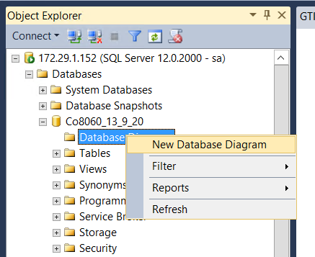
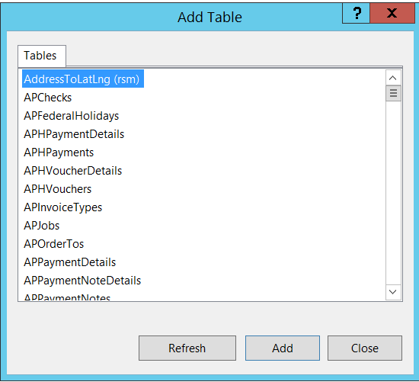
How to create database diagram:

Slide 29
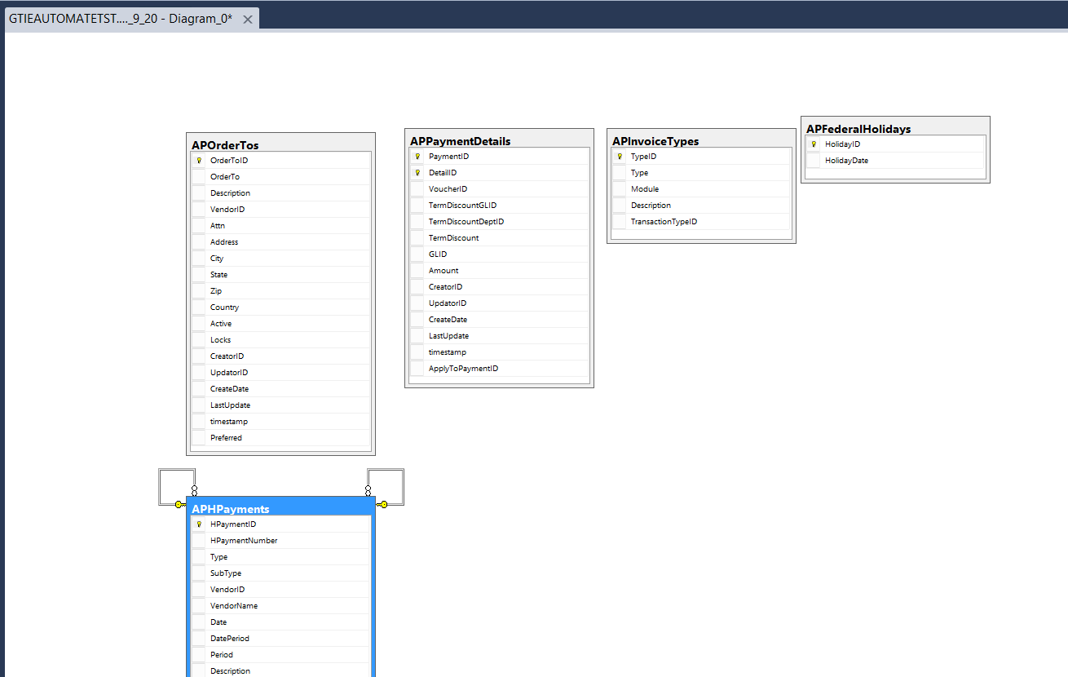
How to create database diagram:

Slide 30
Q&A Session
Thanks.

Slide 31
Daily Task
1.Create table with using not null constraint and insert 2 records in it.
2.Create table with check constraint and insert 2 records in it also show snap short of there restriction error.
3.Create table with set Default constraint on city as 'Mumbai' and insert 2 records with default city.
4.Create 2 table in 1 st table set primary key and insert 3 records and in 2nd table set FOREIGN key and insert 2 records in it.

